Slide 2
Encoders and Decoders in Digital Logic:
Binary code of N digits can be used to store 2^{N} distinct elements of coded information. This is what encoders and decoders are used for. Encoders convert 2^{N} lines of input into a code of N bits and Decoders decode the N bits into 2^{N} lines.

Slide 3
1. Encoders –
An encoder is a combinational circuit that converts binary information in the form of a 2^{N} input lines into N output lines, which represent N bit code for the input. For simple encoders, it is assumed that only one input line is active at a time.
As an example, let’s consider Octal to Binary encoder. an octal-to-binary encoder takes 8 input lines and generates 3 output lines.

Slide 4
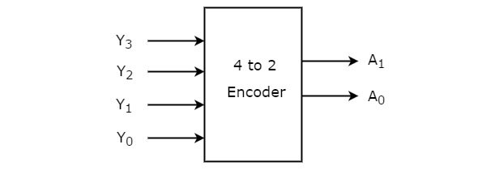
4 to 2 Encoder:
Let 4 to 2 Encoder has four inputs Y₃, Y₂, Y₁ & Y₀ and two outputs A₁ & A₀. The block diagram of 4 to 2 Encoder is shown in the following figure.

Slide 5
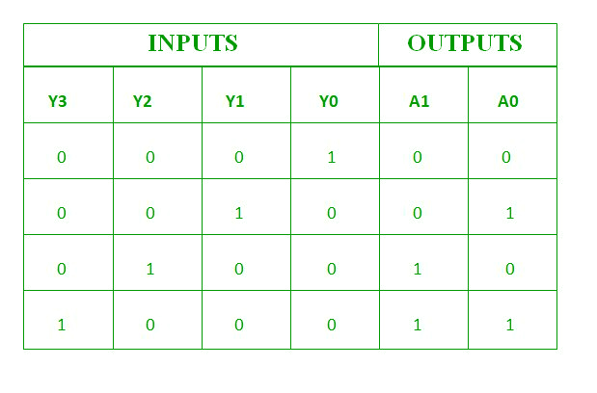
Truth table:
Boolean functions:
A1=Y2+Y3
A0=Y3+Y1

Slide 6
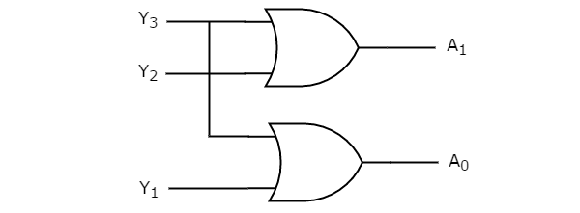
circuit diagram:

Slide 7
Priority Encoder –
A priority encoder is an encoder circuit in which inputs are given priorities. When more than one inputs are active at the same time, the input with higher priority takes precedence and the output corresponding to that is generated. Let us consider the 4 to 2 priority encoder as an example. From the truth table, we see that when all inputs are 0, our V bit or the valid bit is zero and outputs are not used. The x’s in the table show the don’t care condition, i.e, it may either be 0 or 1. Here, D3 has highest priority, therefore, whatever be the other inputs, when D3 is high, output has to be 11. And D0 has the lowest priority, therefore the output would be 00 only when D0 is high and the other input lines are low. Similarly, D2 has higher priority over D1 and D0 but lower than D3 therefore the output would be 010 only when D2 is high and D3 are low (D0 & D1 are don’t care).

Slide 8
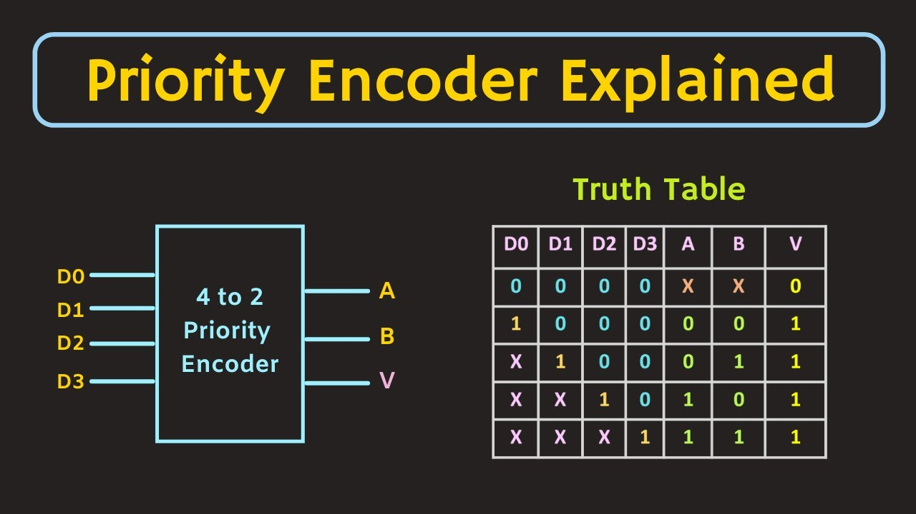
The truth table of a 4 to 2 priority encoder:

Slide 9
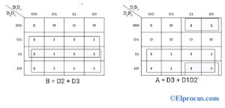
K-map:

Slide 10
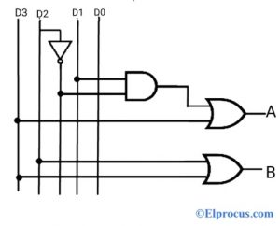
4 to 2 priority encoder circuit diagram:

Slide 11
Decoder:-
Decoder is a combinational circuit that has ‘n’ input lines and maximum of 2^{n} output lines. One of these outputs will be active High based on the combination of inputs present, when the decoder is enabled. That means decoder detects a particular code.

Slide 12
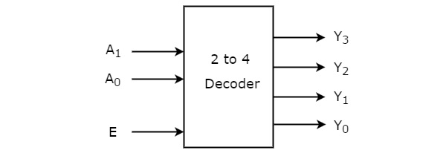
2 to 4 Decoder:

Slide 13
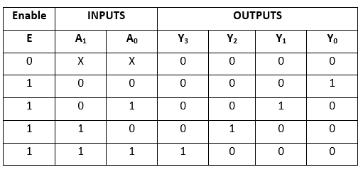

Slide 14
Boolean functions:
Y3=E.A1.A0
Y2=E.A1.A0’
Y1=E.A1’.A0
Y0=E.A1’.A0’

Slide 15
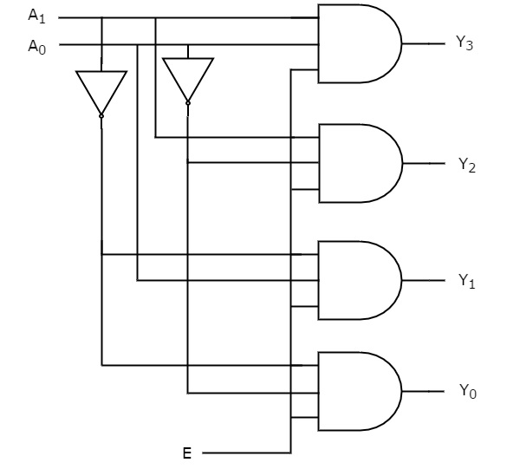
circuit diagram:

